Slide 1

Health App
Scope: Build a Health app to perform health predictions for various scenarios by utilising machine learning algorithms, python libraries with front end UI and host on a cloud platform with public access
Project repo: https://github.com/DCornea5/Final-Project.git
DAJK Team: “Does AI Just Know”?
Daniela Cornea (DC)
Anh Huong (AH)
Josh Lowe (JL)
Kelvin Nguyen (KN)

Slide 2
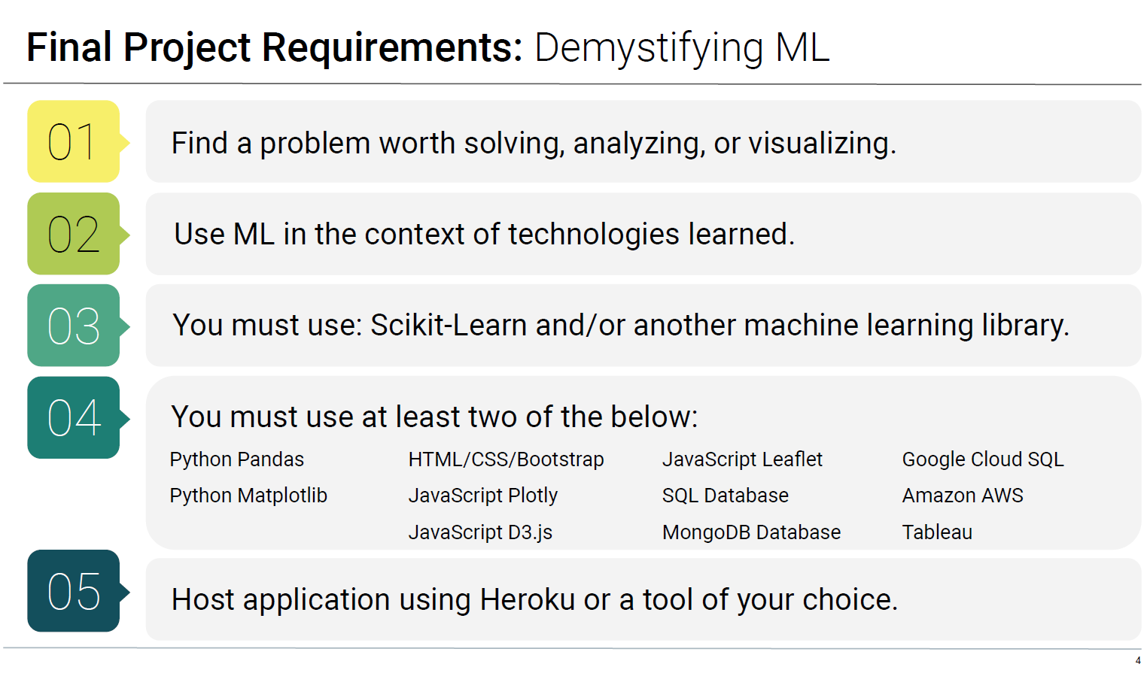
Project High Level Requirements

Slide 3
Technology
Software Applications: Python, pandas, seaborn, matplotlib, plotly express, tqdm, sklearn, xgboost, lightgbm, nltk, pickle, Flask API, HTML/CSS/Bootstrap, etc…
Cloud Platforms: github, heroku
Datasets:
heart_disease.csv
Stress-Lysis.csv
bodyPerformance.csv
TravelInsurancePredictions.csv
psyc.csv
Absenteeism_at_work.csv
Zomato restaurant reviews
Data Sources:
Kaggle, https://www.kaggle.com/datasets/brsdincer/personality-scale-analysis
Dataworld, https://data.world/datasets/open-data

Slide 4
Project Plan
Research project topic and select datasets on various sources
Create project plan and github repo
Project is adopting Agile methodology for software development:
Iterations of design, coding, testing for the app’s front and back-end.
Minimum viable product / Proof of Concept (MVP/POC): a working machine learning model (ML) with user interface (UI) front end that hosted on a cloud platform
Final product: a scalable app with various ML models that hosted on a cloud platform.
On-going task allocations: self-manage, support other team members as required
Documentations:
Presentation pack
Project presentation – live App demo

Slide 5
Project Schedules & Milestones
Date | Seq# | Descriptions | Status
8/4 | 0 | Form the project team | Completed
10/4 18/4 | 1 | Select project topic Select datasets on various open sources ML models - perform exploratory data analysis(EDA), build, test, measure and save the models: Stroke prediction Body performance prediction Stress level prediction Travel Insurance prediction Personality classification | Completed
19/4 | 2 | High level design Present project proposal to instructors | Completed
20 – 29/4 | 3 | Front-end web site design | Completed
26/4 |  | Completed MVP/POC with 1 ML model - Stroke Prediction Model with cloud deployment | Completed
25 – 30/4 | 4 | Cloud platform deployment | Completed
1/5 | 5 | End-to-end testing | In Progress
2/5 | 6 | Project presentation pack Presentation rehearsal | In Progress
3/5 | 7 | Project presentation Project submission | In Progress

Slide 6







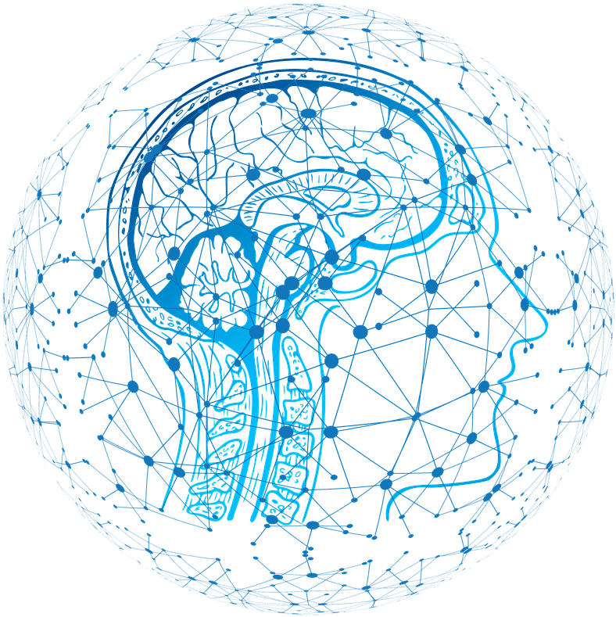
Solution High Level Design (scalable)
Data
User Interface
EDA/ Visualisations
Option1
Option2
Option3
OptionN
Pre-processing
Algorithm
ML Models
Mod_1
Mod_N
Predictor

Slide 7
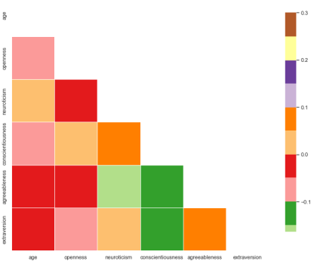
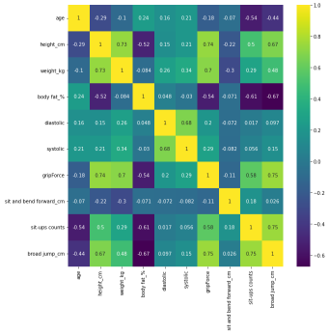
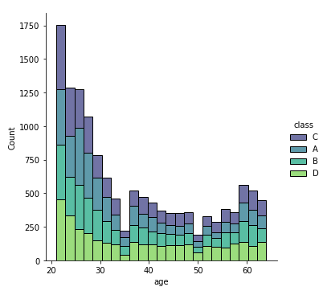
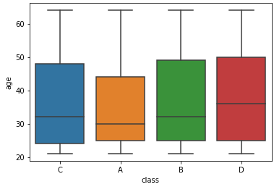
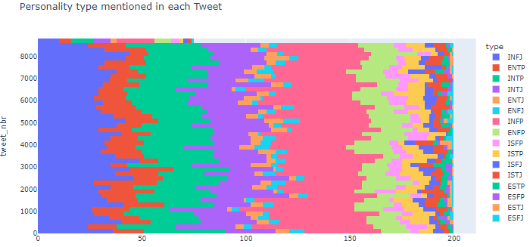
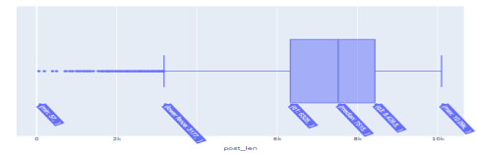
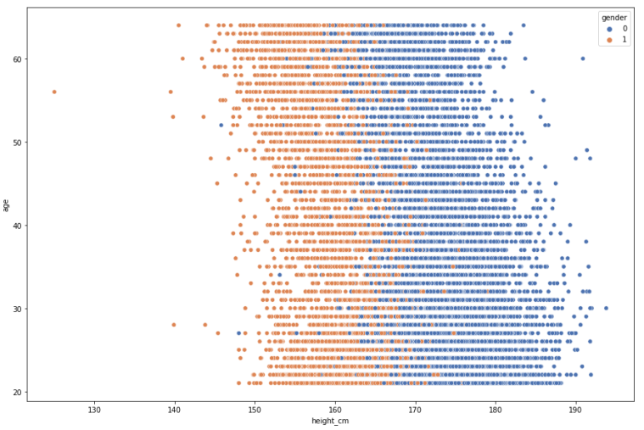
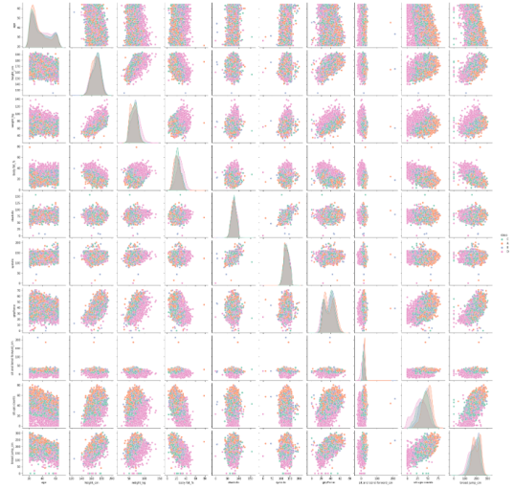
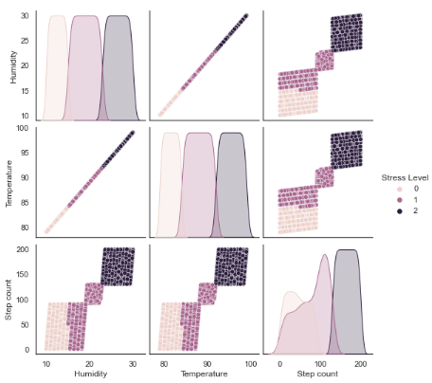
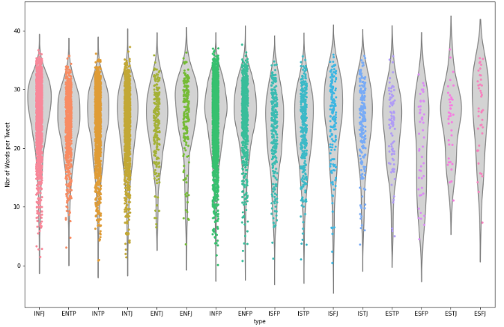
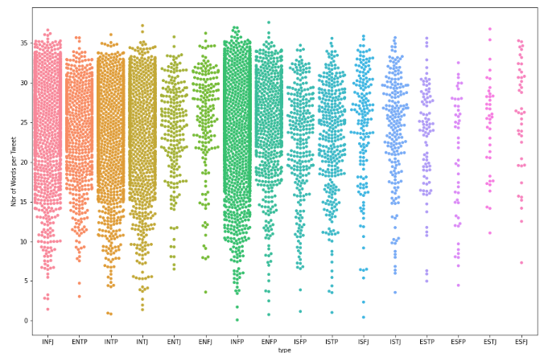
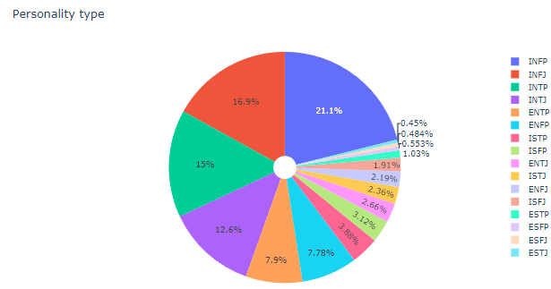
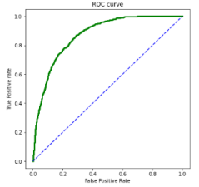
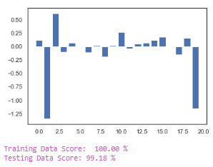
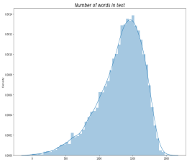
Data Visualisations

Slide 8
Machine Learning Models
“Health” App consists of:
Stroke Prediction
Physical Stress Prediction
Body Performance Classification
Travel Insurance Indicator

Slide 9
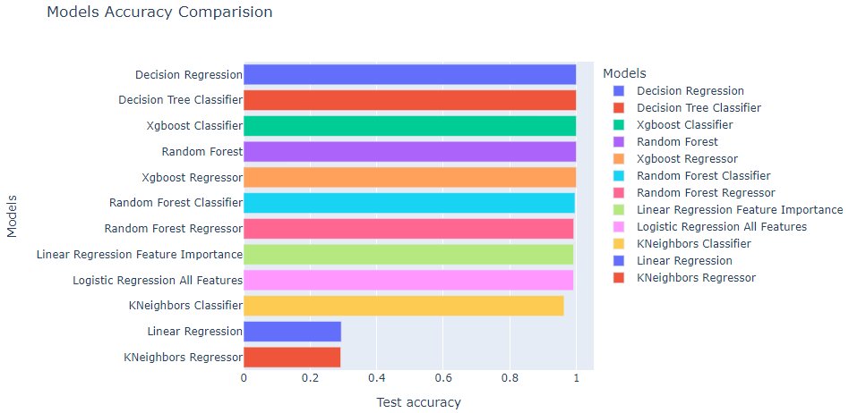
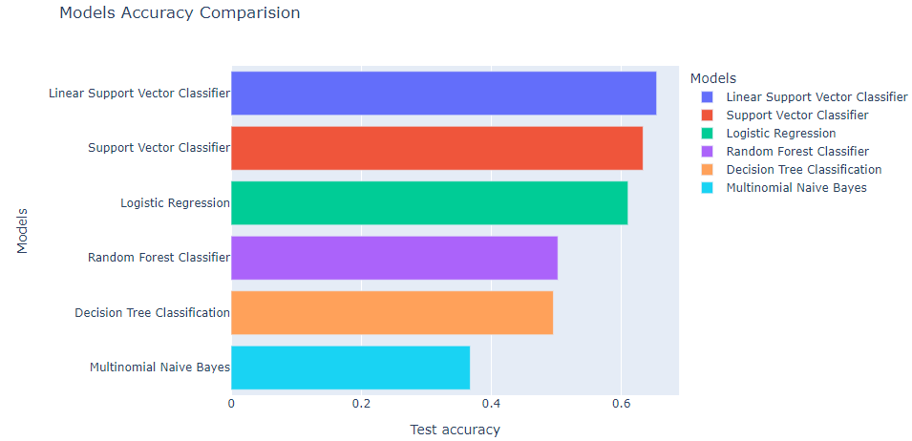
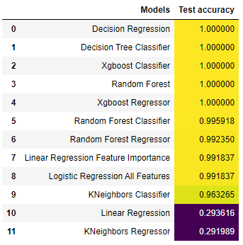
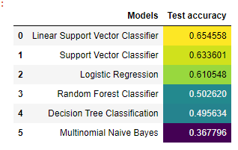
Challenges: Build ML Models
Performed Exploratory Data Analysis (EDA) on datasets
Absenteeism at work: Applied 12 different ML methods, 17 out of 21 columns are seemed relevant. Not user friendly as too many fields are required user input
2. Personality Classification and MTBI (Big5 – Personality Classification based on Tweets): Dropped as they don’t meet the “Health” App theme

Slide 10
Challenges: Build ML Models
Performed Exploratory Data Analysis (EDA) on datasets
Zomato Restaurant Reviews
Observations: Unable to utilise on the project as the data is heavily skewed on the restaurants in India
Etc…
Etc…

Slide 11
Challenges: Cloud Deployment
Github – Heroku:
afdaf
dsafasfd
dsafadf
;lk;k;

Slide 12
Health App Demo

